Slide 1



Akinwumi Oluwatobi Food_wastage Analysis
View in Power BI
Last data refresh:
6/13/2025 5:02:25 AM UTC
Downloaded at:
6/13/2025 5:04:56 AM UTC

Slide 2
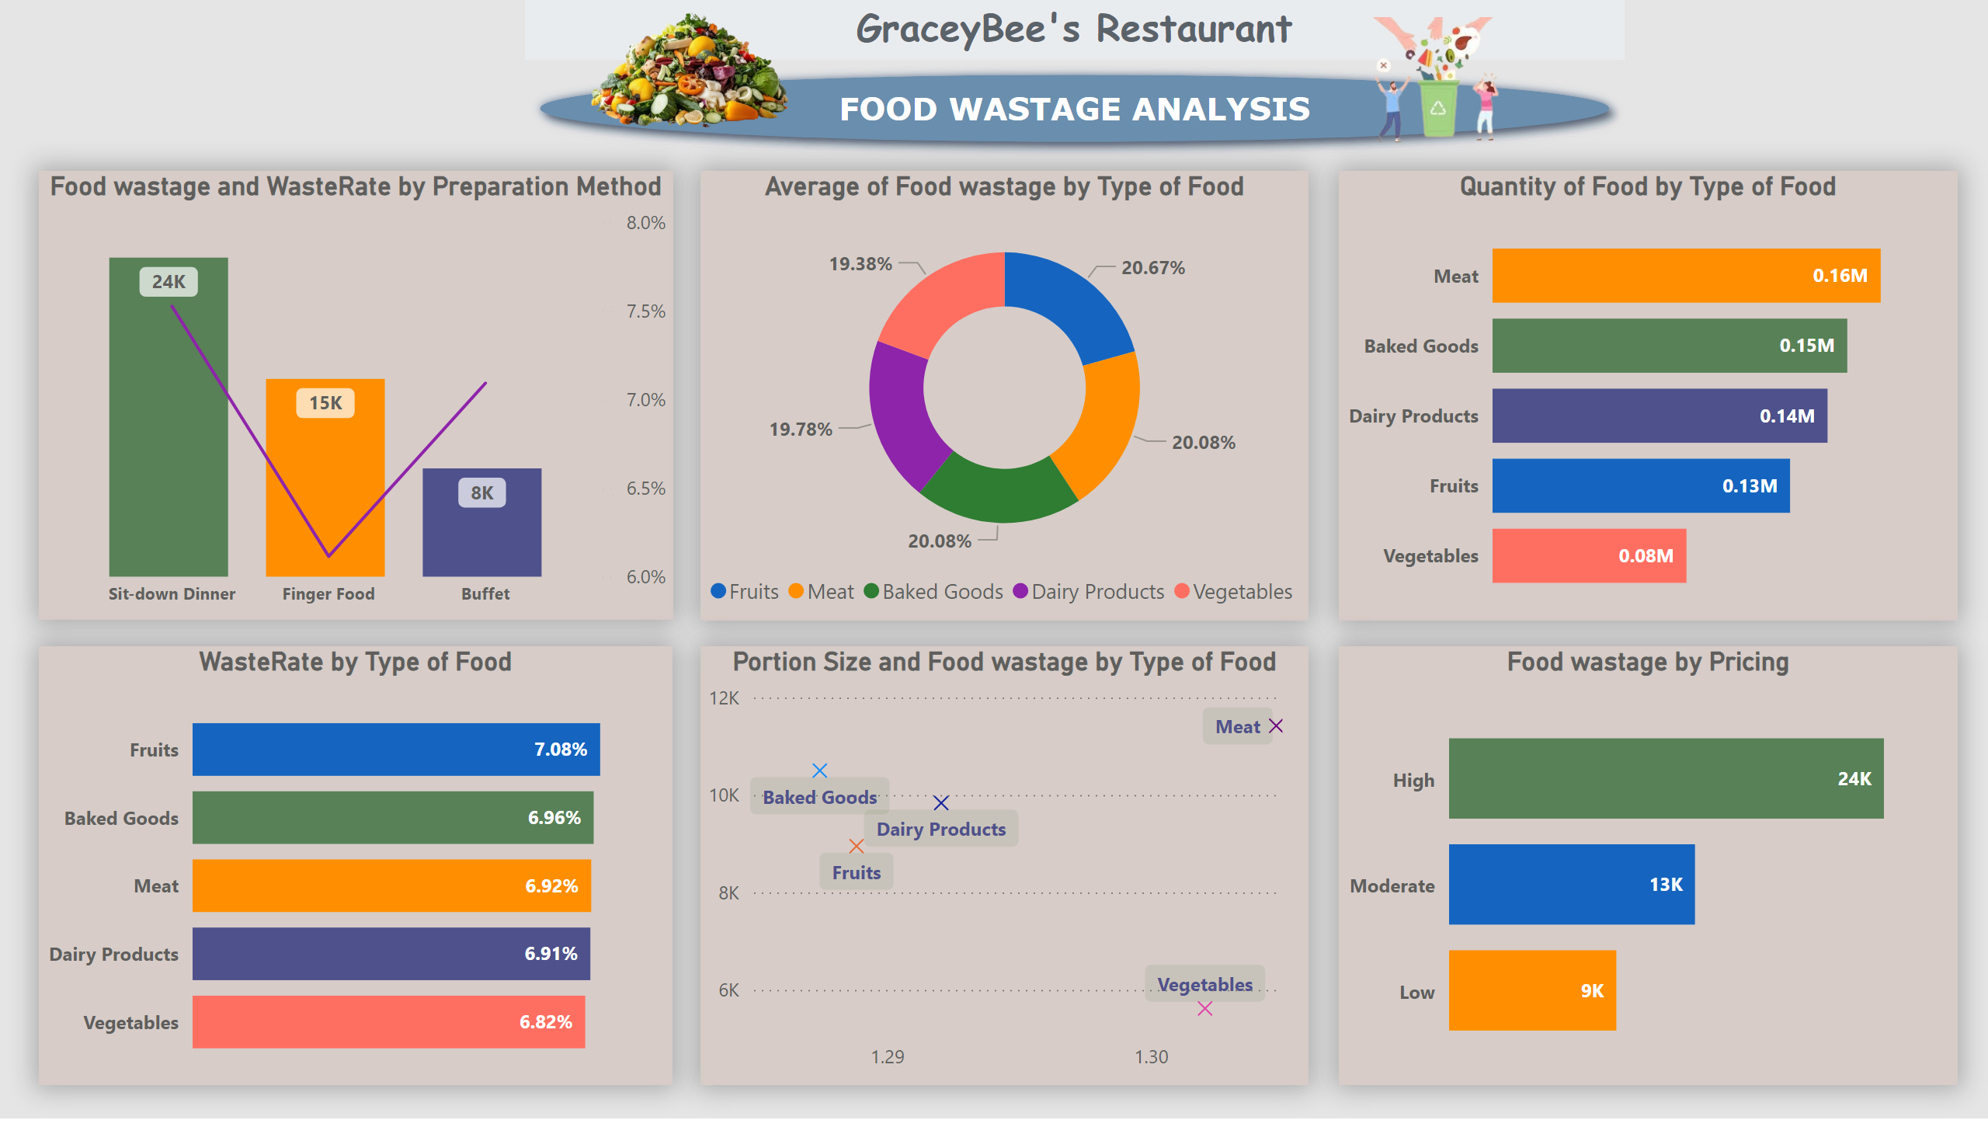
Page 1
Notes:
Food wastage and WasteRate by Preparation Method
No alt text provided
clusteredBarChart
No alt text provided
donutChart
No alt text provided
Quantity of Food by Type of Food
No alt text provided
Portion Size and Food wastage by Type of Food
No alt text provided
Food wastage by Pricing
No alt text provided
image
No alt text provided
image
No alt text provided
GraceyBee's Restaurant
No alt text provided

Slide 3
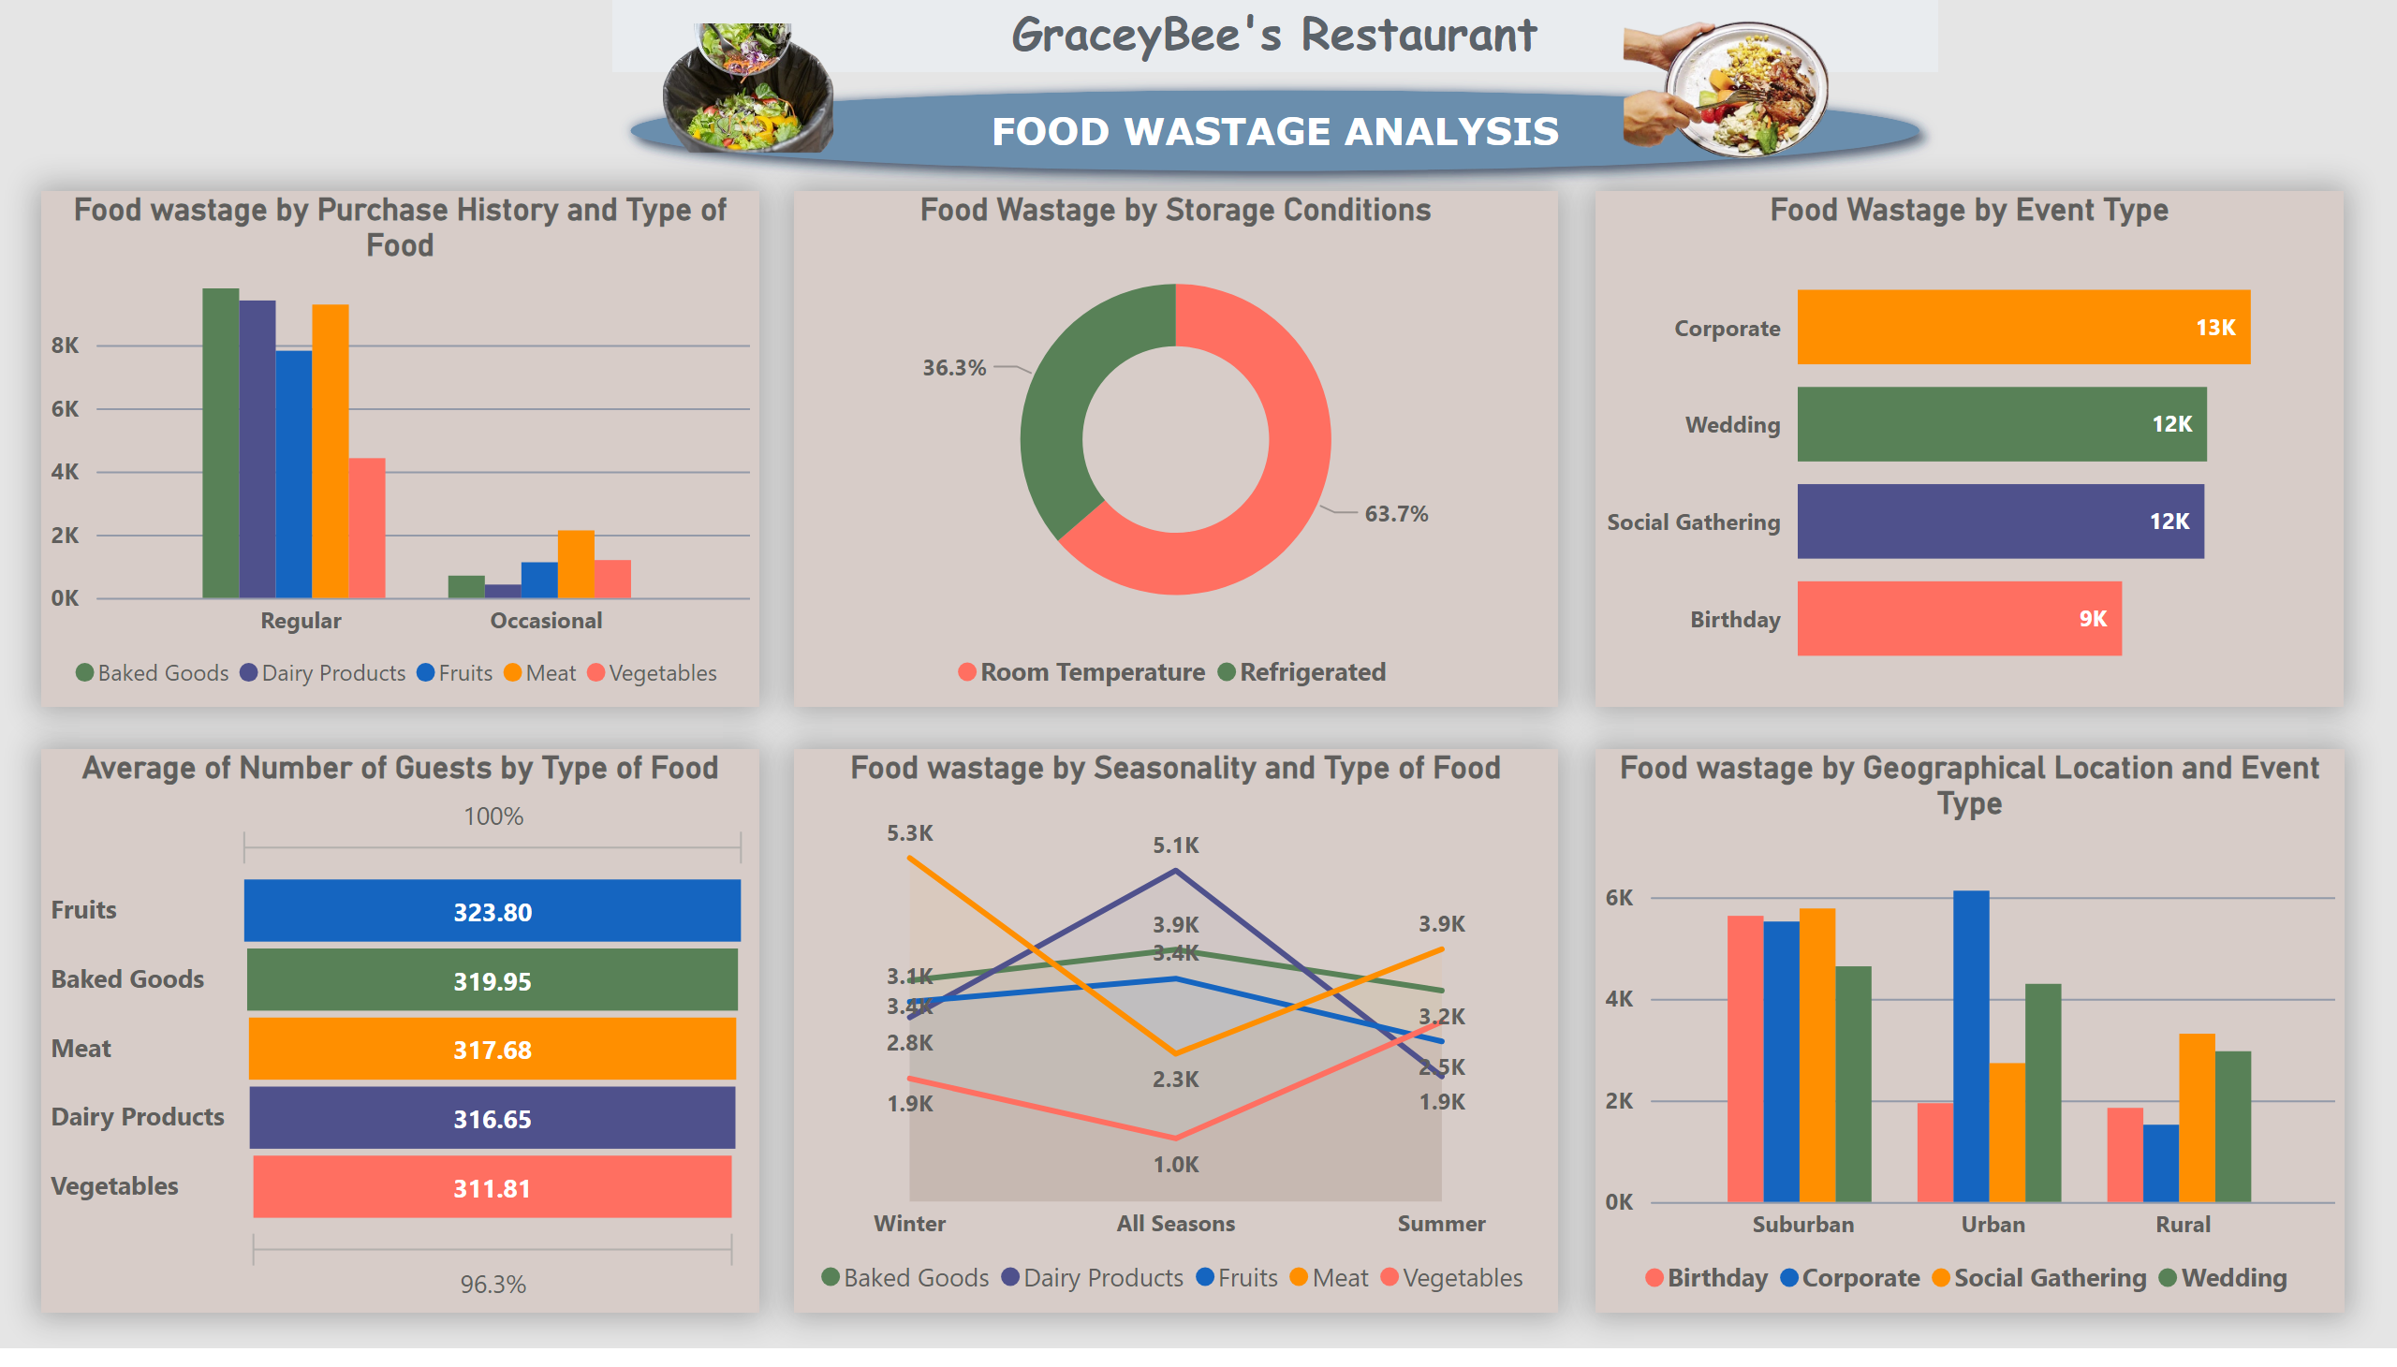
Page 2
Notes:
funnel
No alt text provided
Food Wastage by Storage Conditions
No alt text provided
Food wastage by Purchase History and Type of Food
No alt text provided
Food Wastage by Event Type
No alt text provided
Food wastage by Seasonality and Type of Food
No alt text provided
Food wastage by Geographical Location and Event Type
No alt text provided
GraceyBee's Restaurant
No alt text provided
image
No alt text provided
image
No alt text provided

Slide 4
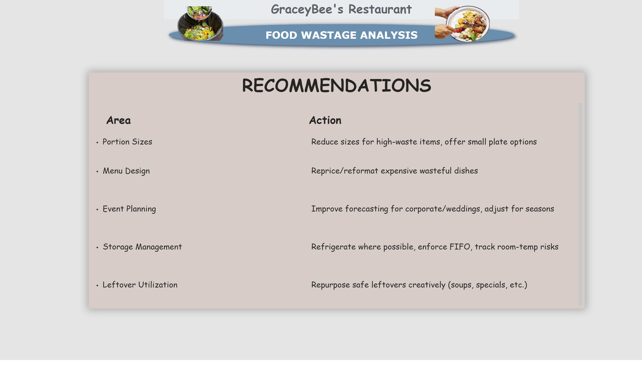
Recommendation
Notes:
GraceyBee's Restaurant
No alt text provided
image
No alt text provided
image
No alt text provided
RECOMMENDATIONS
No alt text provided

